Slide 1
How Our Model Works
A Step-by-Step Pipeline
Training Phase: Split data → Train linear model on normal rows only → Discover 5×x1² from analysis Prediction Phase: Blend both predictions → 0.9×Linear + 0.1×5×x1²
1
Load Data
2
Split Rows
3
Train Linear
4
Discover Formula
5
Blend & Predict
→
→
→
→

Slide 2
STEP 1
Load & Understand the Data
Training File
Test File
Missing Values
2,500 rows × 16 columns
2,500 rows × 15 columns
~1% per feature
15 features: x0 to x14
Same 15 features
About 30 cells blank per column
Cannot train with blanks
Fix: fill with column MEDIAN
Why MEDIAN and not MEAN? Mean of [1, 2, 3, 5000] = 1251. Median = 2.5. Median is not distorted by extreme values.

Slide 3
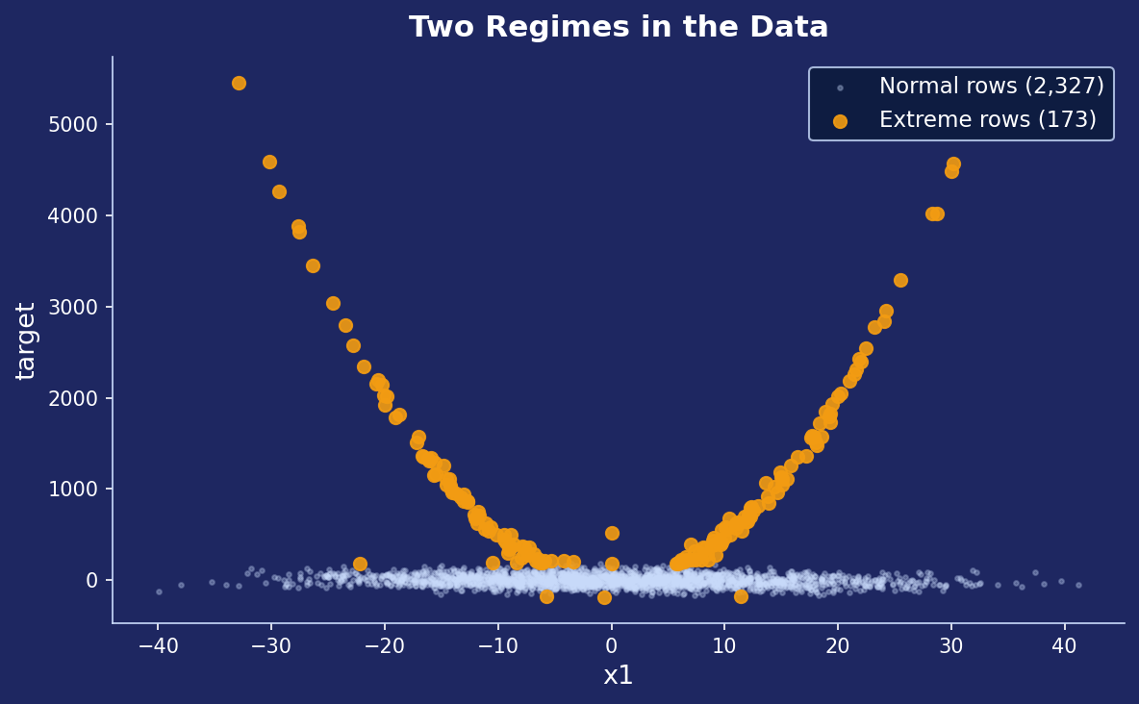
STEP 2
Discover Two Regimes in the Data
IQR Split Method
Q1 = −34.73
25th percentile of target
Q3 = +53.22
75th percentile of target
IQR = 87.95
Q3 − Q1
Upper = +185
Q3 + 1.5×IQR
Lower = −167
Q1 − 1.5×IQR
2,327
Normal rows (93%)
173
Extreme rows (7%)

Slide 4
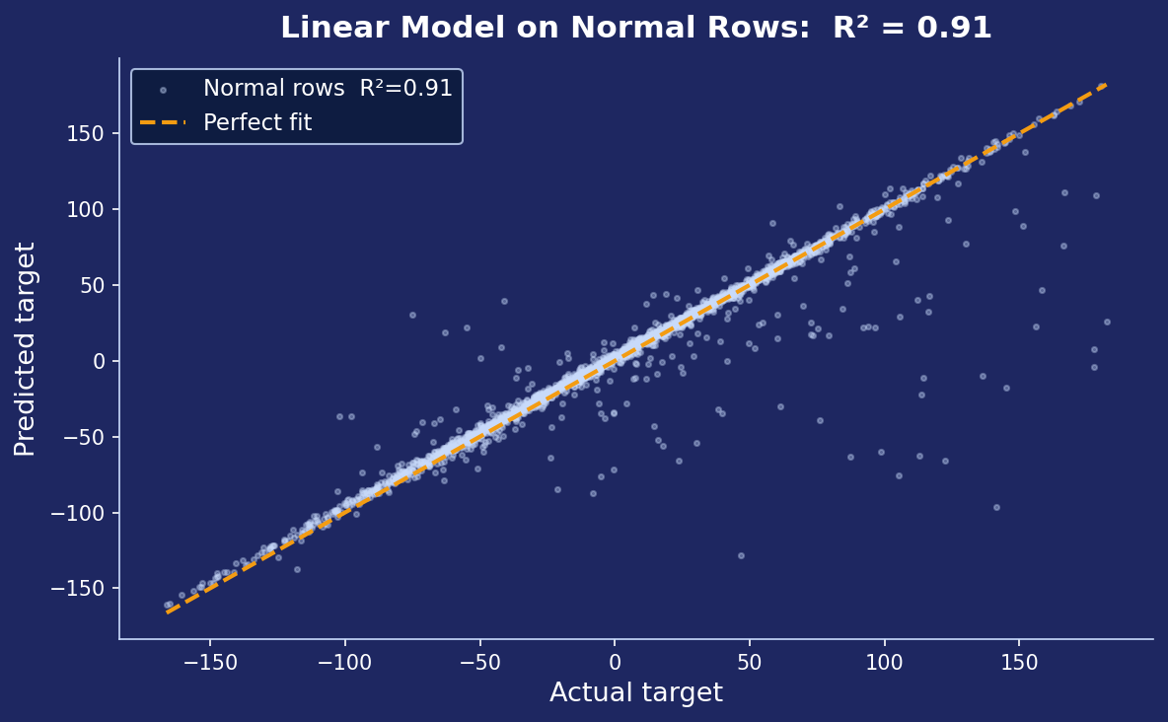
STEP 3
Train Linear Model on Normal Rows Only
What happens here:
Input
2,327 normal rows
(extreme rows EXCLUDED)
Feature Engineering
Add squared features → 30 total
Apply StandardScaler
Fit LinearRegression
Output
30 learned coefficients
x4 most important (+3.09)
R² = 0.91 on normal rows
Why exclude extreme rows? They would distort the linear coefficients.

Slide 5
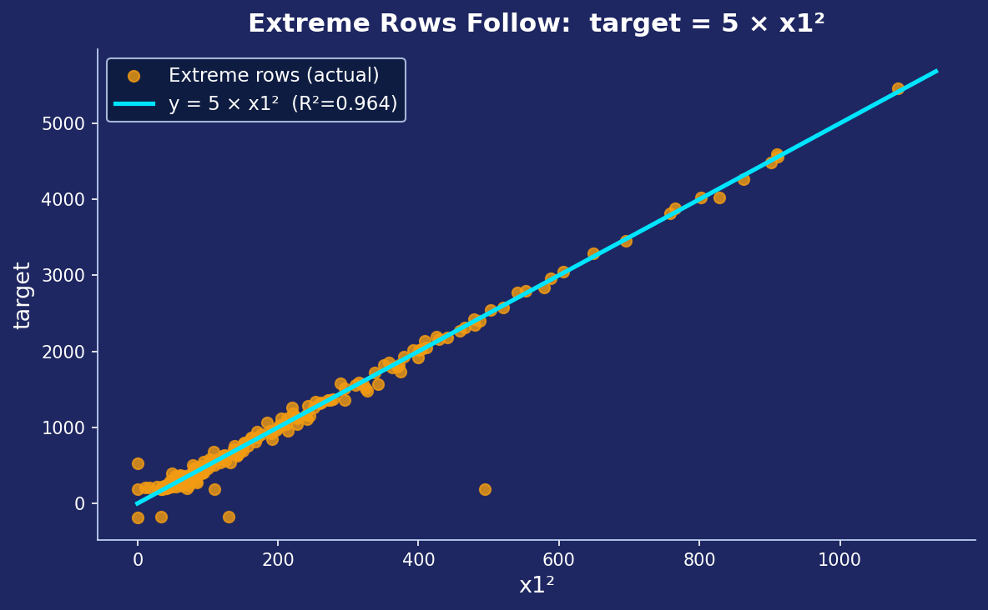
STEP 4
Discover the Extreme Row Formula
Data Analysis — We computed target ÷ x1²
for every extreme row:
Every extreme row → ratio ≈ 5.0
∴ target = 5 × x1² (R² = 0.964)
This formula was NOT trained — it was discovered by inspection.

Slide 6
STEP 5
Blend: Through CV
ŷ = 0.9 × LinearModel(x) + 0.1 × 5 × x₁² = 0.9 × L(x) + 0.5 × x₁²
Normal Row (x1 = 5, true target = 45)
Extreme Row (x1 = 30, true target = 4,500)
Linear model predicts:
45 ✓ (correct — model trained on rows like this)
Linear model predicts:
~50 ✗ (wrong — never trained on extreme rows)
5 × x1² formula gives:
5 × 25 = 125 ✗ (too high for this row)
5 × x1² formula gives:
5 × 900 = 4,500 ✓ (correct formula!)
Blend 0.9×45 + 0.1×125:
40.5 + 12.5 = 53 (close to true 45)
Blend 0.9×50 + 0.1×4500:
45 + 450 = 495 (partial boost)
Result:
Small error from 10% formula weight — acceptable
Result:
Still underpredicted but FAR better than 50
Normal rows: blend works well
Extreme rows: partial boost toward truth
Weight 0.90 found by searching 0.0 → 1.0 (step 0.05) via 5-fold cross-validation → best CV R² = 0.0769

Slide 7
Complete Pipeline at a Glance
TRAINING
Load 2,500 rows
Split by IQR
Feature Engineering
Train LinearRegression
15 features + target
Fill missing with MEDIAN
2,327 normal | 173 extreme
(extreme rows set aside)
Add x0²…x14² → 30 features total
FIT on 2,327 normal rows ONLY
Learn 30 coefficients → R²=0.91
→
→
→
Manual Analysis of 173 Extreme Rows
target / x1² ≈ 5.0 for every extreme row → Formula: 5 × x1²
PREDICT
Any Test Row
Linear Model
Formula
Final Prediction
15 feature values
(unknown target)
→
p1 = L(x)
(from trained model)
→
p2 = 5 × x1²
→
ŷ = 0.9×p1 + 0.1×p2
Results: Private score = 0.08138 | Public score = 0.00108 | CV estimate = 0.0819 | Theoretical upper bound = 0.9983

Slide 8
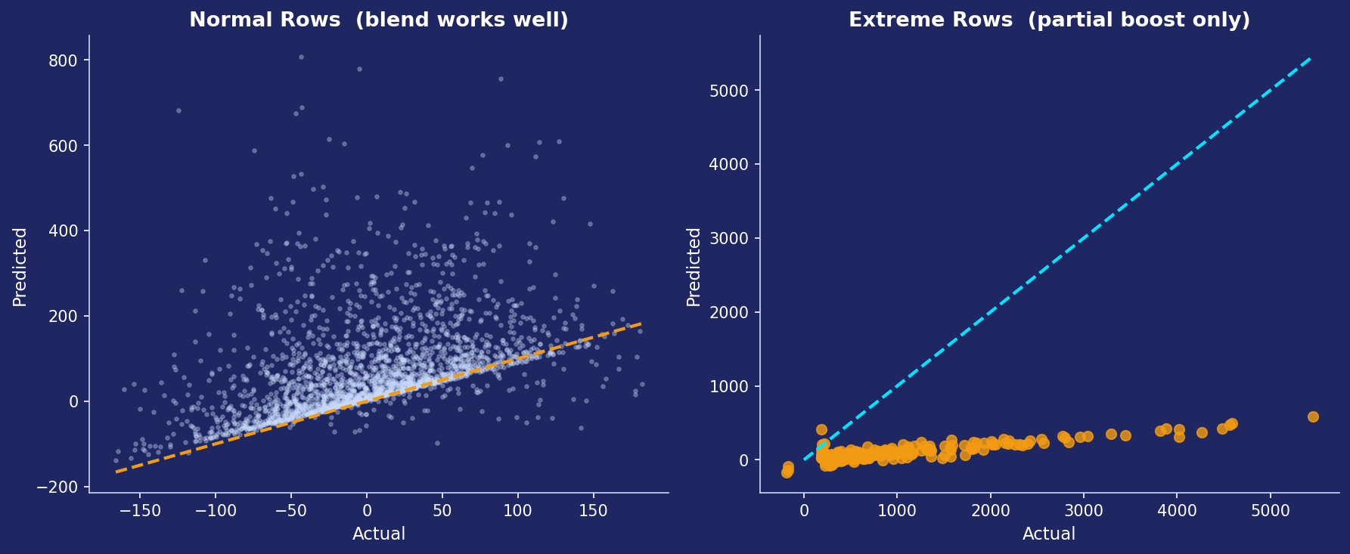
RESULTS
How Well Does the Blend Work?
CV R² (honest)
Private Score
Public Score
Upper Bound
0.0819
Our cross-validation estimate
0.0754
Final Kaggle result — matches CV!
0.0011
Public set had no extreme rows
0.9983
If extreme rows predicted perfectly

Slide 9
Is this a good model?

Slide 10
ŷ = 2.15484171
+ 3.08979202 * x4
- 2.09834688 * x8
- 1.98161375 * x3
- 1.69610386 * x2
- 1.31464750 * x5
+ 1.11888343 * x6
+ 0.95544124 * x14
- 0.71678789 * x12
+ 0.70931006 * x9
+ 0.66366482 * x7
- 0.65748324 * x1
+ 0.52312649 * x10
+ 0.49461707 * x1_sq
+ 0.32662340 * x0
- 0.05457616 * x3_sq
- 0.04646810 * x11
- 0.02414184 * x14_sq
+ 0.01712182 * x12_sq
+ 0.01589473 * x6_sq
- 0.00358914 * x13
+ 0.00297905 * x0_sq
+ 0.00236237 * x9_sq
+ 0.00235617 * x7_sq
+ 0.00210337 * x11_sq
- 0.00110662 * x8_sq
- 0.00096704 * x10_sq
- 0.00062712 * x2_sq
- 0.00044938 * x4_sq
+ 0.00017473 * x5_sq
- 0.00006735 * x13_sq
Conclusion

Slide 11
KEY LEARNINGS
Lessons from This Competition
1
EDA before modelling
Visualising the target distribution revealed the two-regime structure — the single most important discovery. Without this, all models failed.
2
Outlier ≠ Noise
The extreme rows were not noise — they were a second pattern (5×x1²). Removing them improved the linear model, using a formula captured them.
3
Simple models can win
LinearRegression + a simple mathematical formula outperformed XGBoost, Neural Networks, SVR, and Kernel Ridge.
4
Cross-validation is essential
XGBoost scored R²=0.99 on training data but −0.14 on unseen data. Only CV revealed the truth.
5
Ensemble blending
Neither the linear model alone nor the x1² formula alone scored well. Combining them at 0.9/0.1 achieved the best result.

Slide 12
Code block Link:
https://colab.research.google.com/drive/15k-9U3dNhQFjzTfFTkAA5dqSEBxsW2Tc?usp=sharing

